Slide 1

Rate Limiter using Spring Cloud Gateway

Slide 2


Agenda
Introduction
Overview of Spring Cloud Gateway
Rate Limiting in Spring Cloud Gateway
Real-World Example: Movie Ticket Booking
Real-World Example: Food Ordering Service
Types of Rate Limiting
Challenges and Considerations
Advantages of Rate Limiting

Slide 3
Introduction
A Rate Limiter is a tool that controls how many times a user or system can make a request to a service within a specific time frame.
It stops the service from getting too busy with too many requests at the same time.
Rate limiter controls how many requests a user can make to a service in a certain period.

Slide 4
Why is Rate Limiting Important?
Prevents Overload
Ensures Fairness
Protects Against Misuse:

Slide 5
Spring Cloud Gateway is a tool that helps manage and direct traffic between different microservices in an application.
Purpose: It acts as a front door to your services, controlling how requests are routed and handled.
Overview of Spring Cloud Gateway
Key Features
Routing
Filters
Load Balancing
Rate Limiting
Easy Integration

Slide 6


Real-World Example: Movie Ticket Booking
Example: Bahubali Movie
The leading online ticket booking website crashed a day prior to the release as it experienced heavy traffic due to a huge amount of people flocked to the website to pre-book the movie tickets.

Slide 7
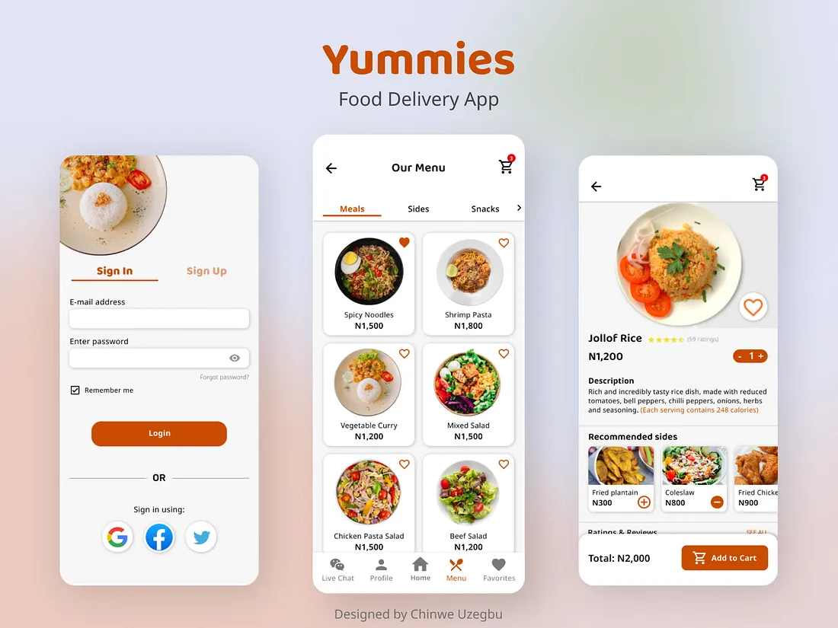
Real-World Example: Food Ordering Service
A food ordering service experiences a server crash during peak hours, causing users to be unable to place orders and resulting in a loss of sales and customer trust.
The incident leads to a backlog of pending orders and delays in service recovery.

Slide 8
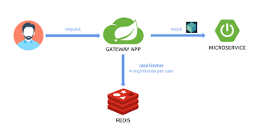
Rate Limiter Architecture

Slide 9
Handling Spikes in Traffic:
Balancing Between User Experience and Protection:
Adjusting Limits Dynamically Based on Load:
Challenges and Considerations

Slide 10
Advantages of Rate Limiting
Prevent Service Overload
Ensures Fair Access
Enhances Security
Improves User Experience

Slide 11


